Slide 1
DOMAIN NAME SYSTEM

Slide 2
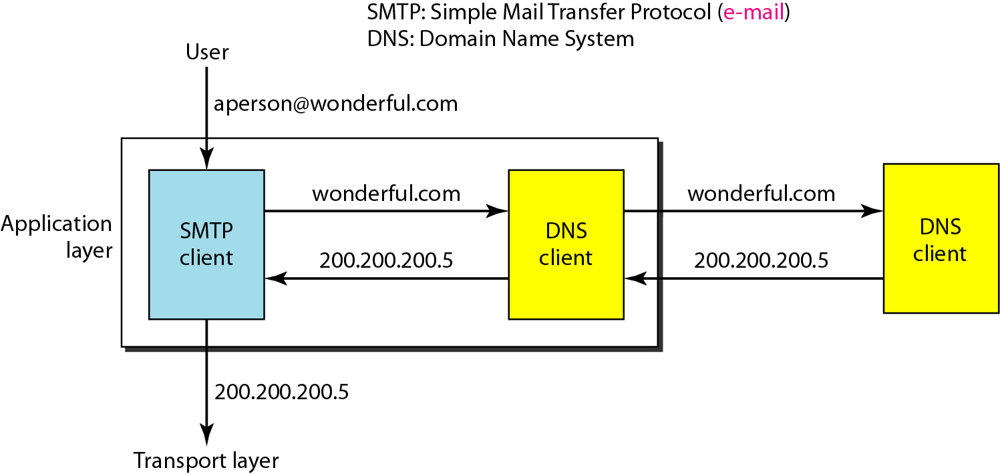
Example of using the DNS service

Slide 3
NAME SPACE
To be unambiguous, the names assigned to machines must be carefully selected from a name space with complete control over the binding between the names and IP addresses.

Slide 4
DOMAIN NAME SPACE
To have a hierarchical name space, a domain name space was designed. In this design the names are defined in an inverted-tree structure with the root at the top. The tree can have only 128 levels: level 0 (root) to level 127.

Slide 5
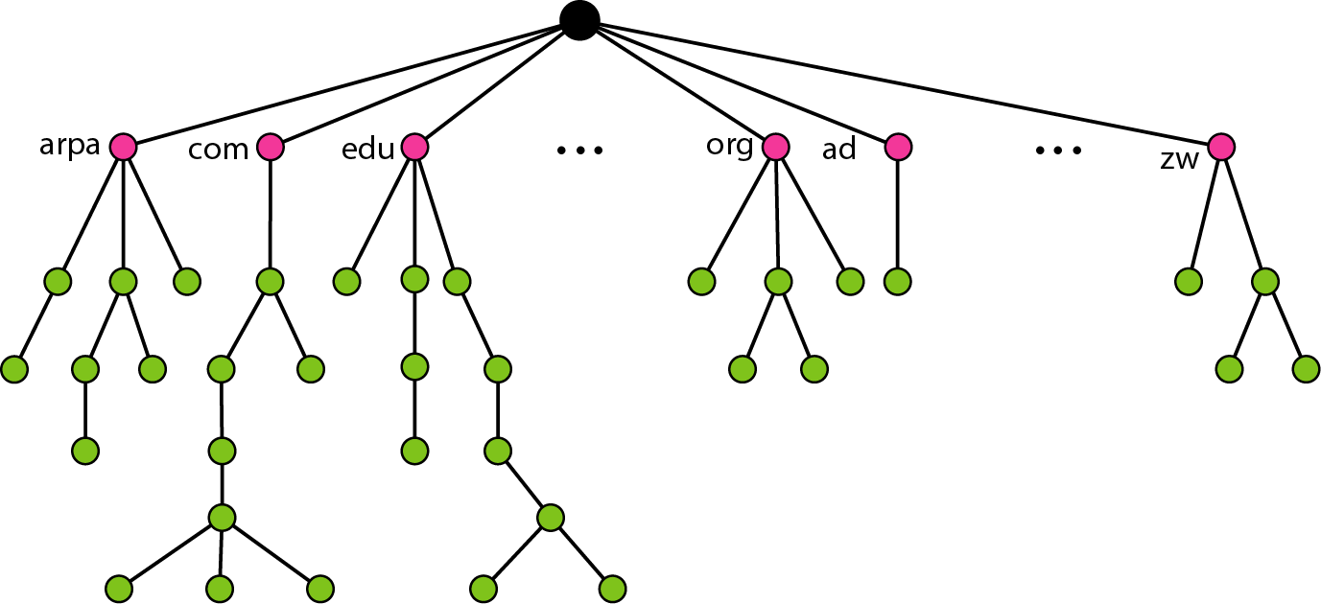
Domain Name Space

Slide 6
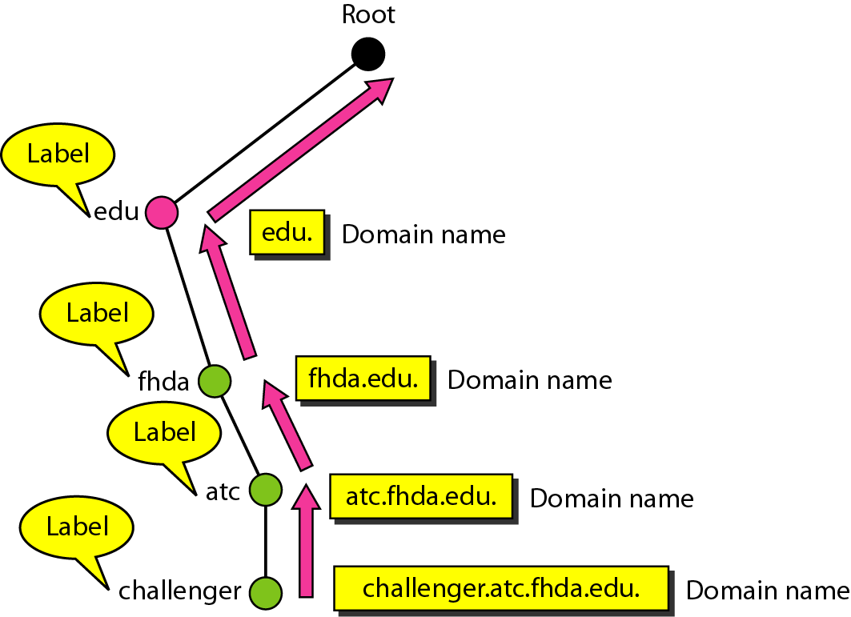
Domain Names and Labels

Slide 7

FQDN and PQDN

Slide 8
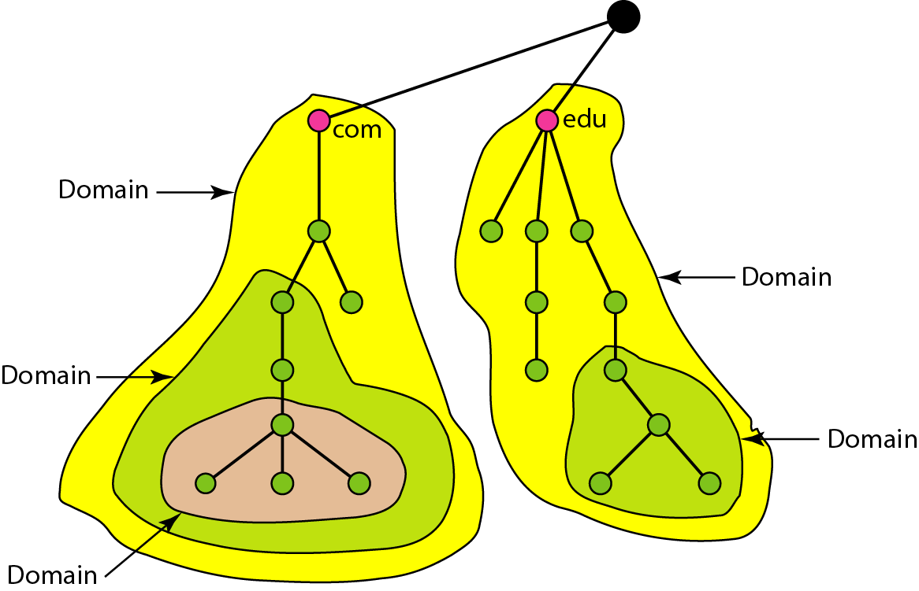
Domains

Slide 9
DISTRIBUTION OF NAME SPACE
The information contained in the domain name space must be stored. However, it is very inefficient and also unreliable to have just one computer store such a huge amount of information

Slide 10
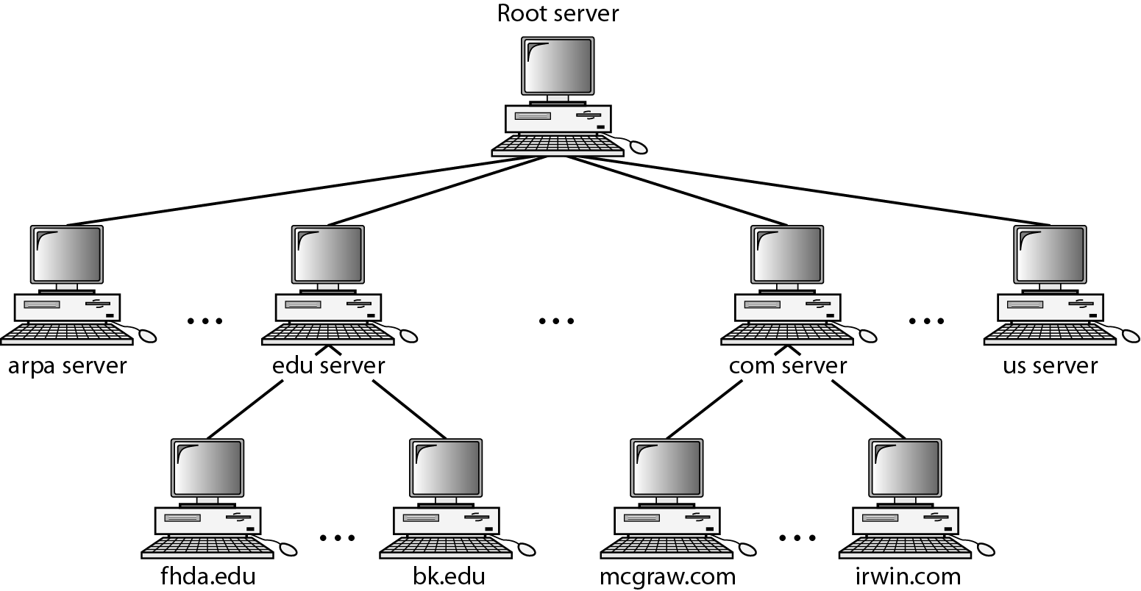
Hierarchy of name servers

Slide 11
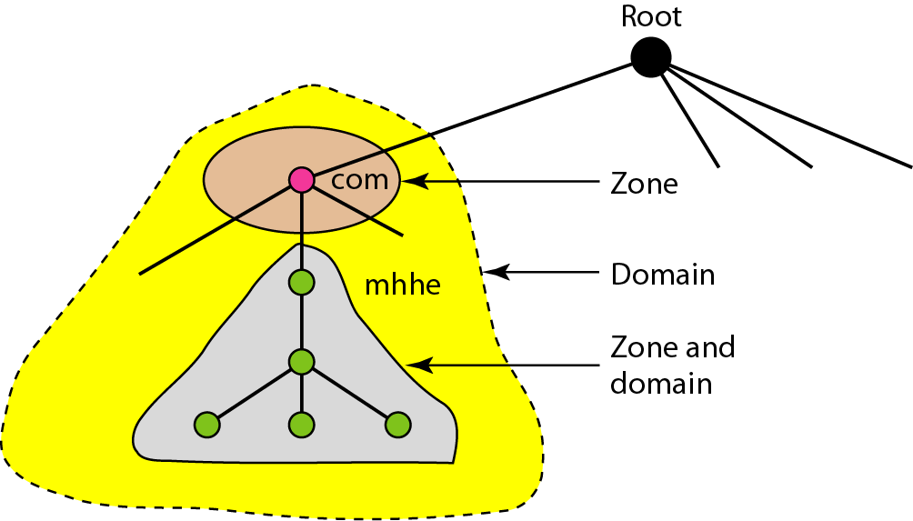
Zones and domains

Slide 12
A primary server loads all information from the disk file;
the secondary server loads all information from the primary server.
When the secondary downloads information from the primary, it is called zone transfer.

Slide 13
DNS IN THE INTERNET
DNS is a protocol that can be used in different platforms. In the Internet, the domain name space (tree) is divided into three different sections: generic domains, country domains, and the inverse domain.

Slide 14
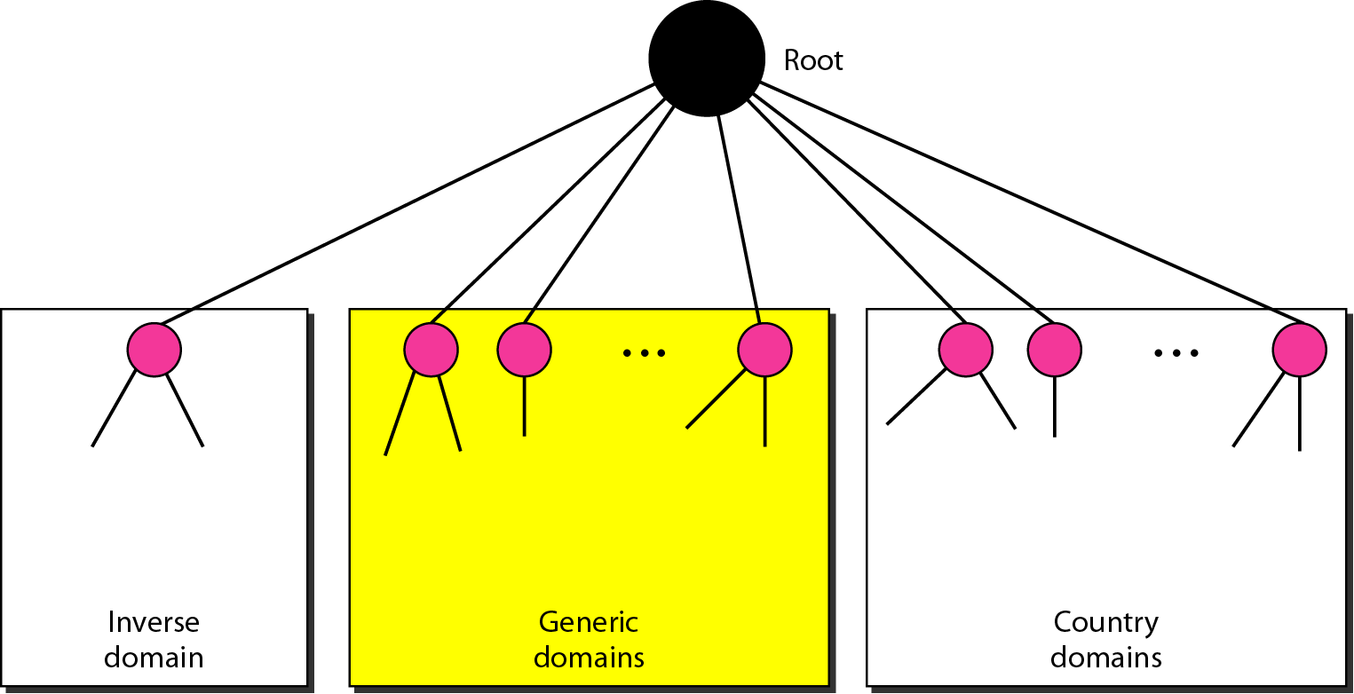
DNS IN THE INTERNET

Slide 15
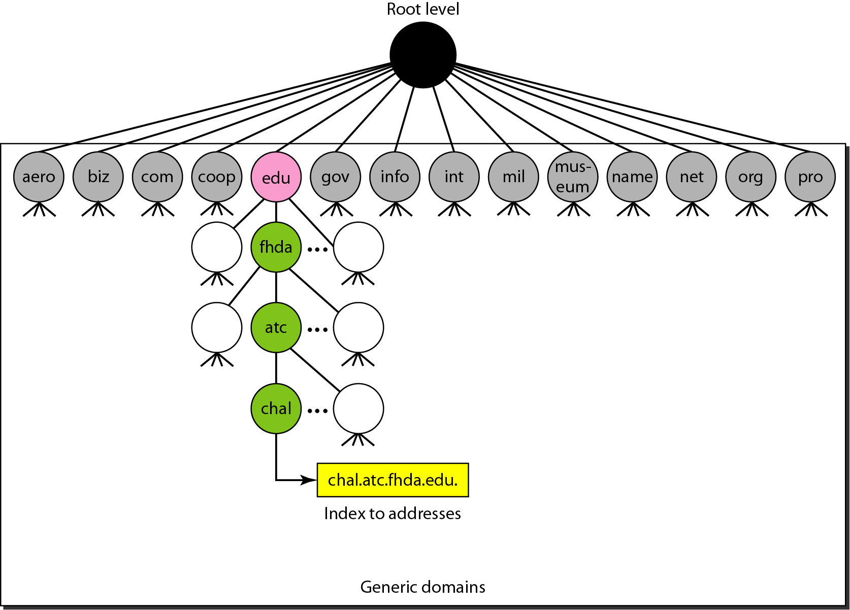
Generic domains

Slide 16
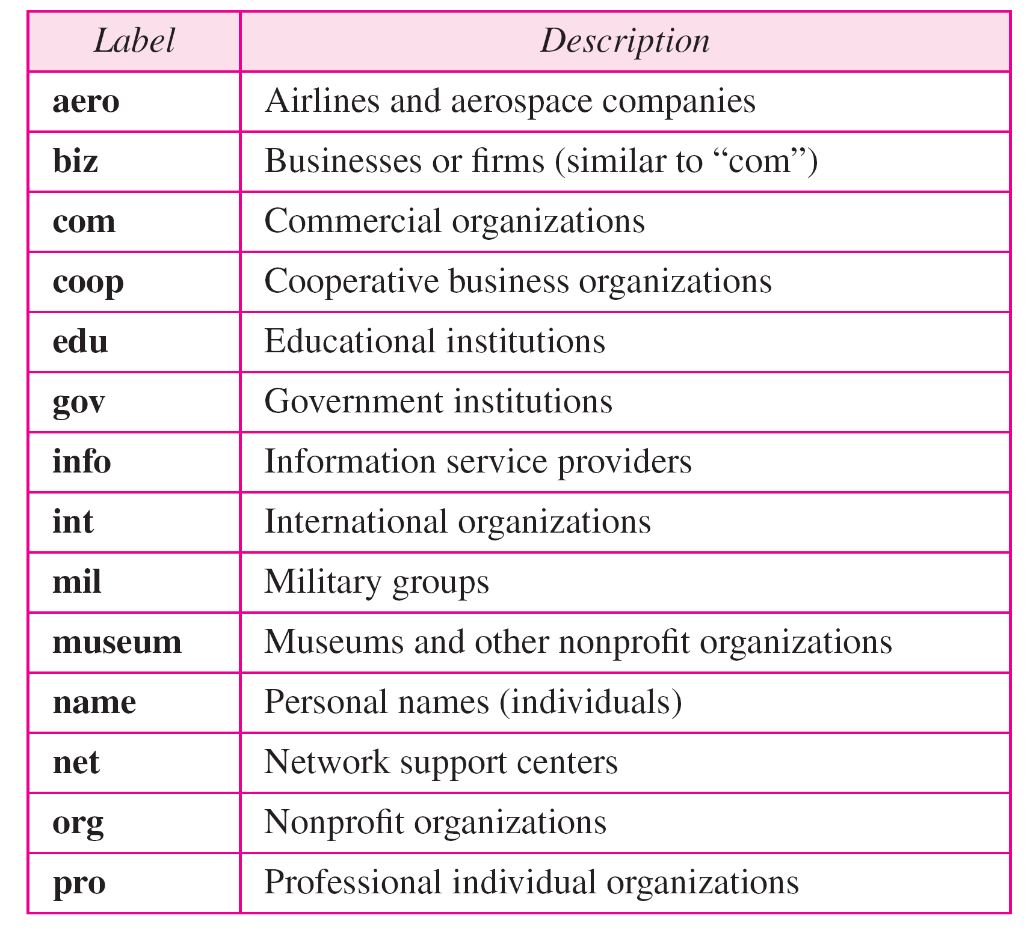
Generic domain labels

Slide 17
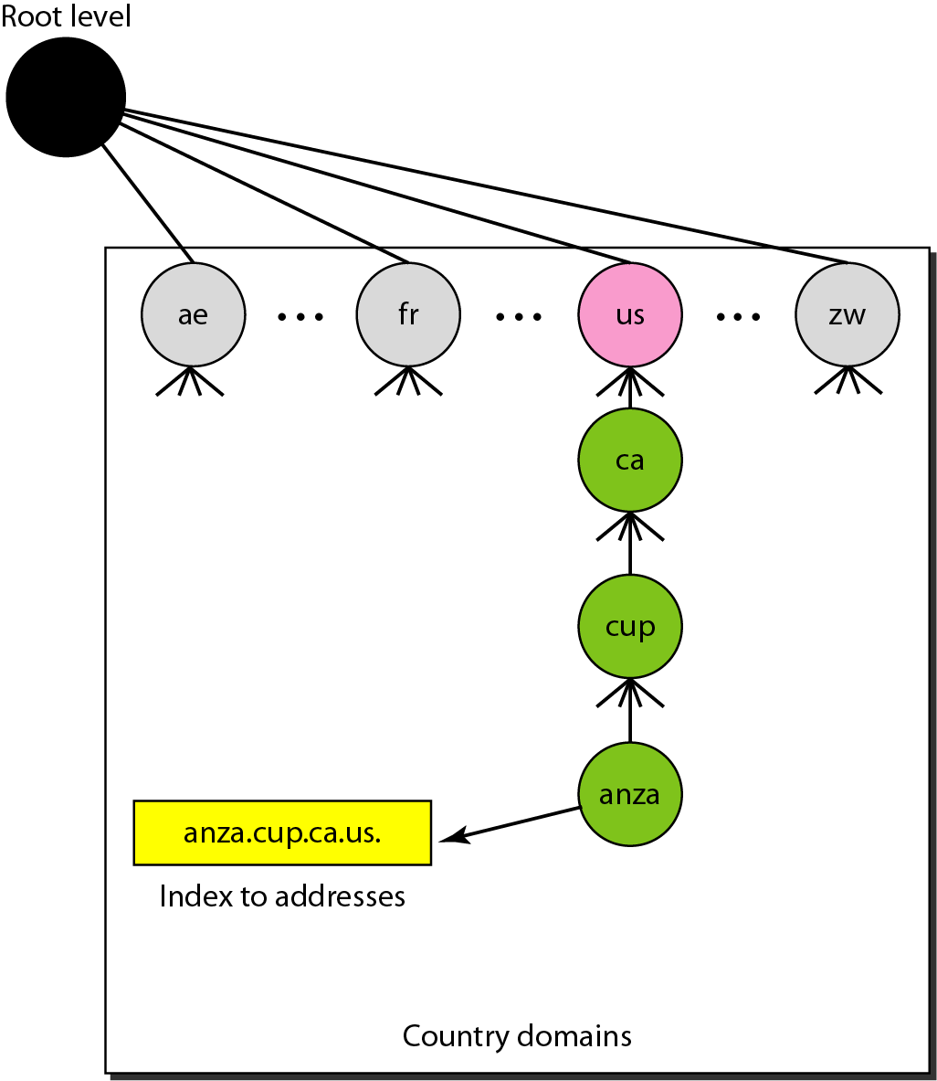
Country domains

Slide 18
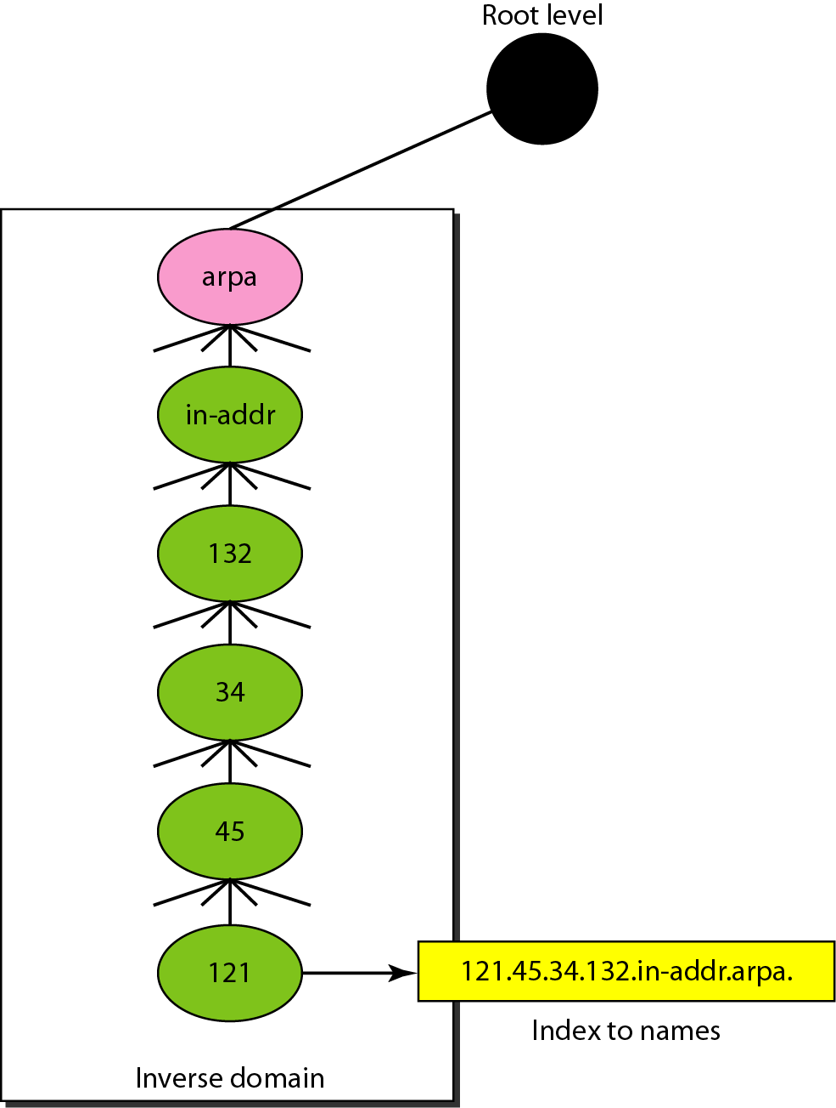
Inverse domain

Slide 19
RESOLUTION
Mapping a name to an address or an address to a name is called name-address resolution.

Slide 20
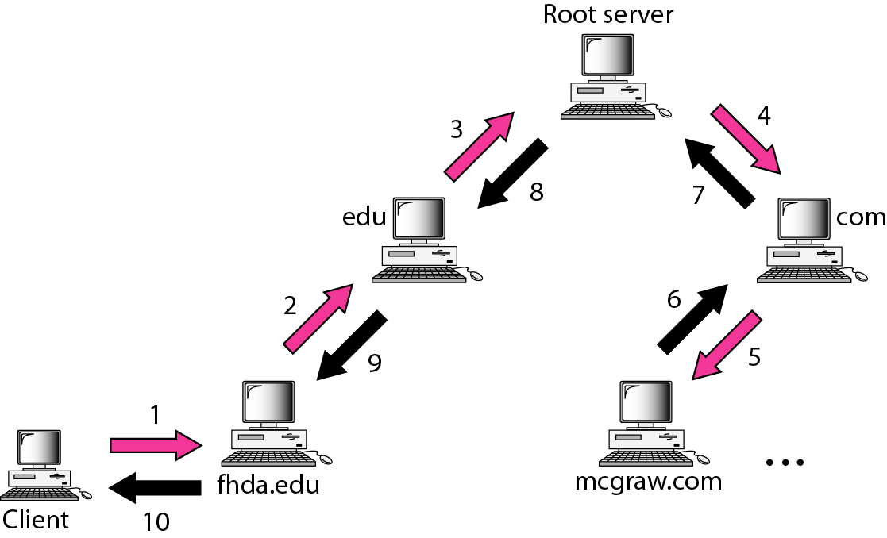
Recursive resolution

Slide 21
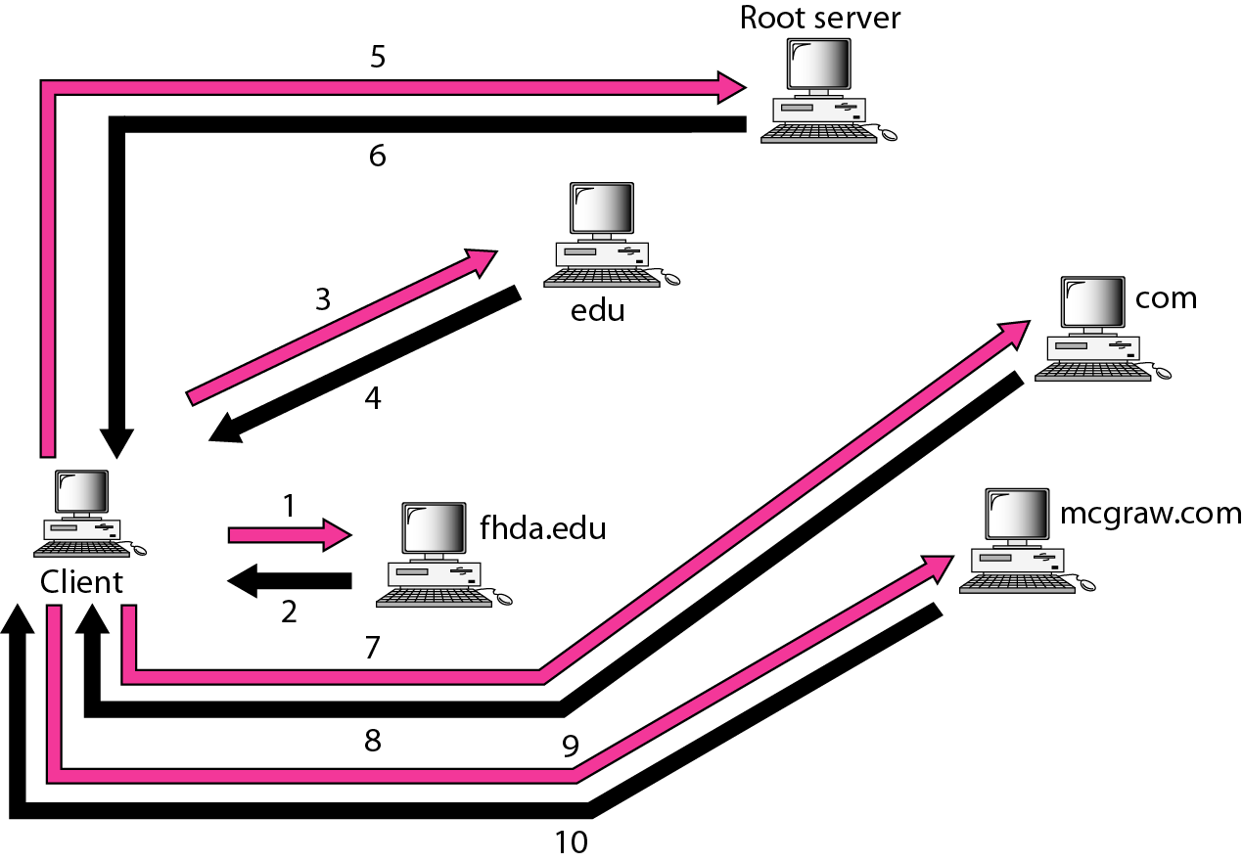
Iterative resolution

Slide 22
DNS MESSAGES
DNS has two types of messages: query and response. Both types have the same format. The query message consists of a header and question records; the response message consists of a header, question records, answer records, authoritative records, and additional records.

Slide 23
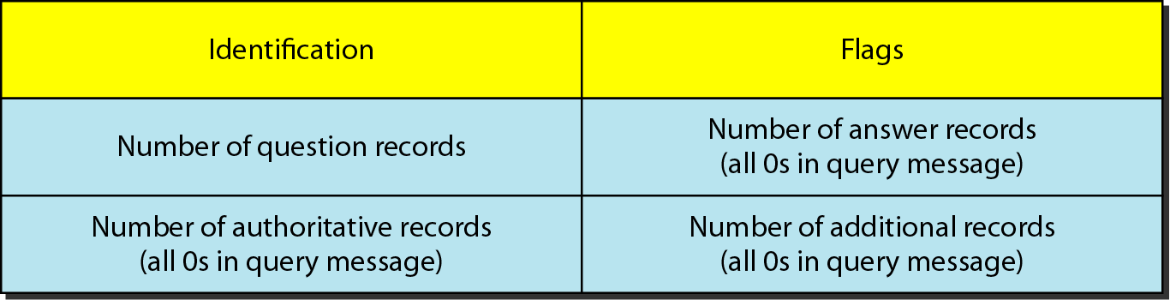
Header format

Slide 24
TYPES OF RECORDS
Two types of records are used in DNS. The question records are used in the question section of the query and response messages. The resource records are used in the answer, authoritative, and additional information sections of the response message.

Slide 25
REGISTRARS
How are new domains added to DNS? This is done through a registrar, a commercial entity accredited by ICANN. A registrar first verifies that the requested domain name is unique and then enters it into the DNS database. A fee is charged.

Slide 26
DYNAMIC DOMAIN NAME SYSTEM (DDNS)
The DNS master file must be updated dynamically. The Dynamic Domain Name System (DDNS) therefore was devised to respond to this need. In DDNS, when a binding between a name and an address is determined, the information is sent, usually by DHCP to a primary DNS server. The primary server updates the zone. The secondary servers are notified either actively or passively.

Slide 27
ENCAPSULATION
DNS can use either UDP or TCP. In both cases the well-known port used by the server is port 53. UDP is used when the size of the response message is less than 512 bytes because most UDP packages have a 512-byte packet size limit. If the size of the response message is more than 512 bytes, a TCP connection is used.

Slide 28
THANK YOU

